Slide 1
Risk assessment
Hazard | Risk | Precautions
Scissors and pins | Sharp objects – could injure | Pupils told to take care, teachers supervise, only 1 per group
Moving turbine blades | Could hit person, danger to eyes | Pupil told to take care, adults supervise, plenty of room to spread out between groups
Hairdryers | Cables are trip hazard; could get hot | Cables kept out of the way or taped to floor; hairdryers used on cold setting only, and only by an adult
Moving around the room | Trip hazard, bumping into others | Pupils told no running, to be aware of others, to stay in groups and spread out
Covid | Close proximity, blowing air at wind turbines | No blowing air unless away from others.

Slide 2
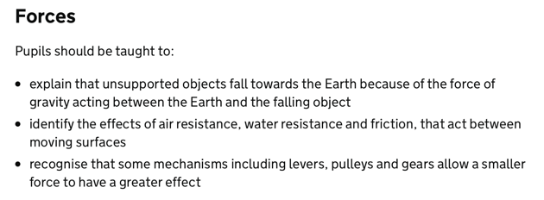
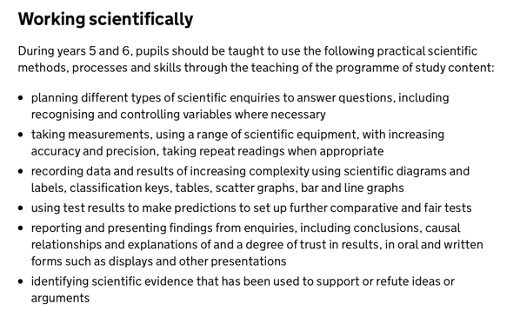
Curriculum links – KS2

Slide 3

Wind power: are you a fan?
A workshop for KS2 pupils originally devised for British Science Week 2021
(Theme: Innovating for the Future)
Author: Christina Astin
Funded by
Notes:
PRESENTING (1 MIN)
Introduce the workshop and presenter (if relevant)

Slide 4
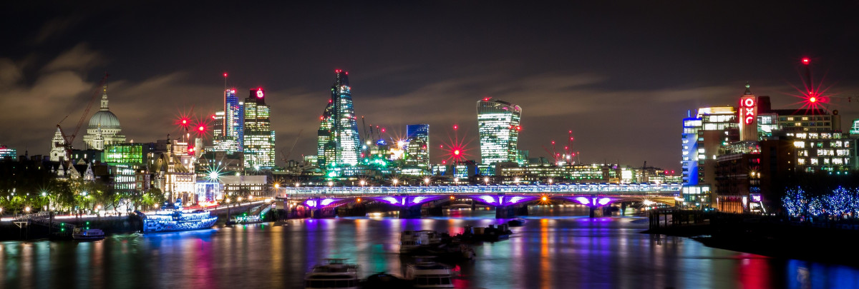
How different would your day so far have been without electricity?
Notes:
THINK-PAIR-SHARE (3 MINS)
We use a lot of energy! Night-time photo of London.
What have you used electricity for today?
PUPILS SHARE IDEAS – in pairs. If not sure, look around room? Then share in plenary.

Slide 5
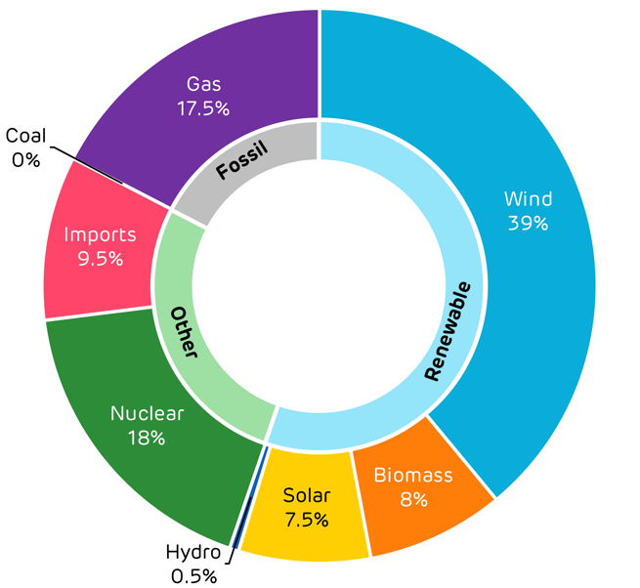
Where do we get our electricity from?
Pic: https://www.dmsinteractive.co.uk
Notes:
Q&A (3 MINS)
Doughnut pie chart shows example of resources used in UK to generate electricity.
Questions:
Which resource was used to generate the most electricity?
Why are hydro, solar, biomass and wind called “renewable”?
Why are coal and gas called fossil fuels?
Teachers: you might like to refer to this BBC page for more information on energy resources: https://www.bbc.co.uk/bitesize/topics/zc3g87h/articles/zdycr2p
Be aware that biomass takes many different forms (e.g. bio-ethanol, methane from rotting waste) and can be considered non-renewable.

Slide 6
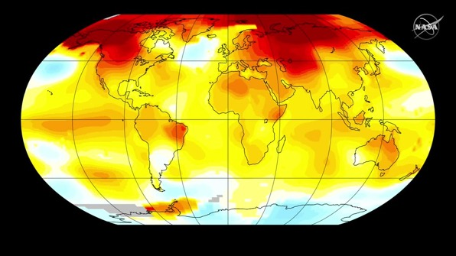
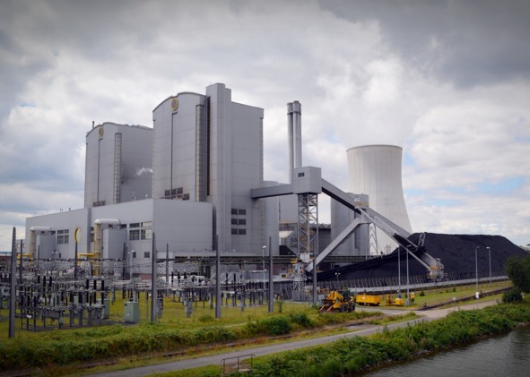
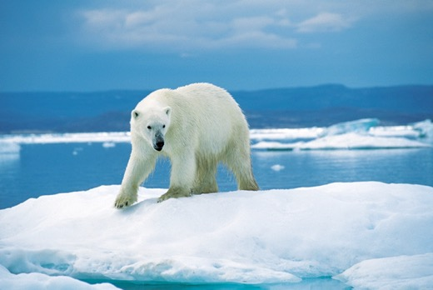
Coal, oil and gas
Notes:
PRESENTING (1 MIN)
Fossil fuels – Refer to Y3 study of rock cycle – take millions of years to form (hence ‘fossil’) – coal, oil, gas. Have to be mined or drilled for.
When these are burned to generate electricity - releases greenhouse gases which leads to global warming (and other problems) – changing our weather & causing polar ice to melt.

Slide 7

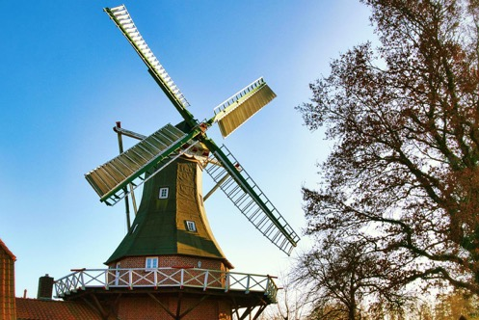
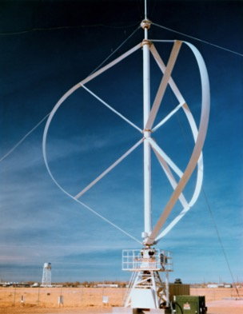
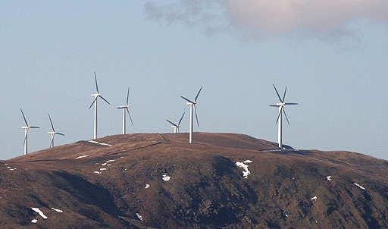
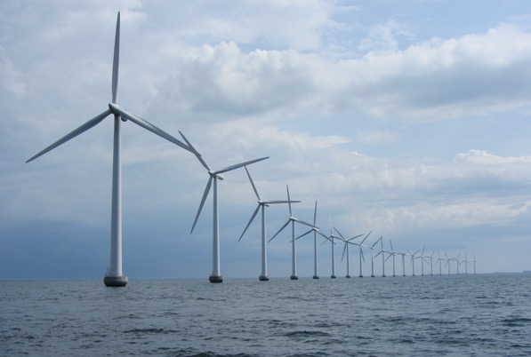
Notes:
PRESENTING (2 MINS)
Wind power not new!
Old fashioned windmills used for 1000s of years to grind corn to make flour.
Lower pictures – modern wind turbines use wind to turn turbines to generate electricity. Once built, a wind turbine has no emissions and no fuel costs – the wind is free! These are vertical axis turbines – pupils can put left finger horizontally and rotate other hand around it top demonstrate.
QUESTION: Why are they positioned on hills or out at sea? Because more wind there to capture.
Last picture (top right) is a vertical axis wind turbine.
Pupils can stick finger vertically upwards and use other hand to rotate around it – vertical axis.

Slide 8
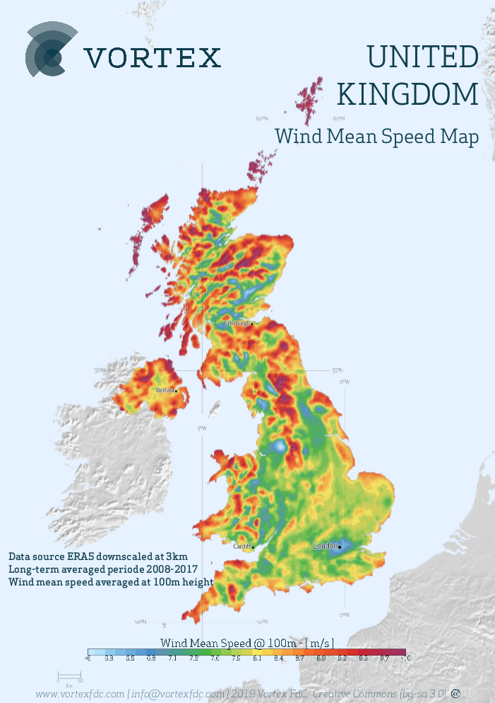
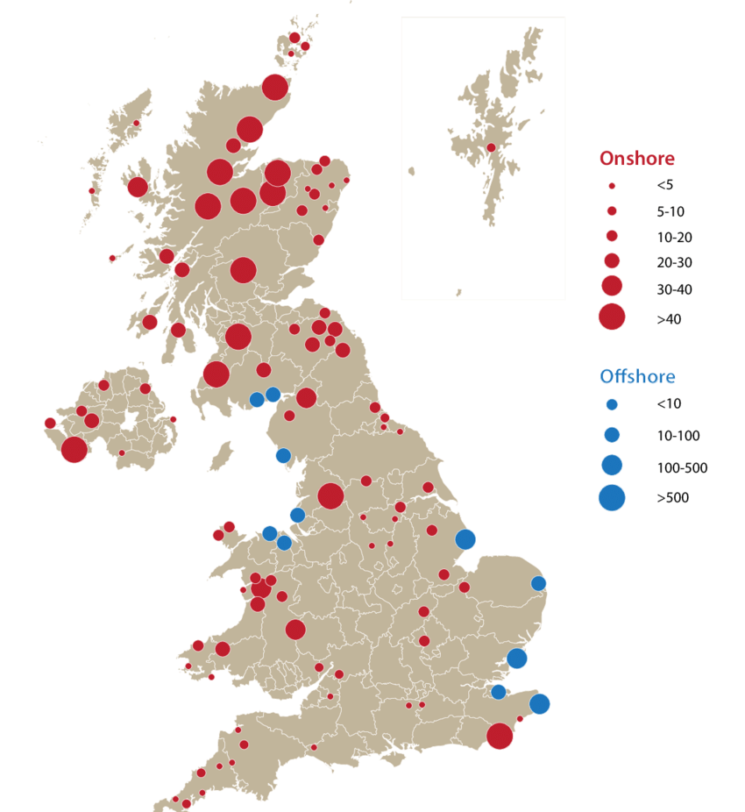
https://www.researchgate.net/figure/UK-Wind-Farm-Location-and-Capacities-Map-2010-DECC-2011a_fig10_293121524
www.vortexfdc.com/info@vortexfdc.com/2019
Notes:
PRESENTING (2 MINS)
Left hand picture maps all wind farms (= collections of wind turbines). Bigger blobs = more turbines. Red = onshore; blue = offshore.
Right hand picture is a map of average wind speed – blue = low wind speed; red = high wind speed (windier)
Note how the 2 maps match up.

Slide 9
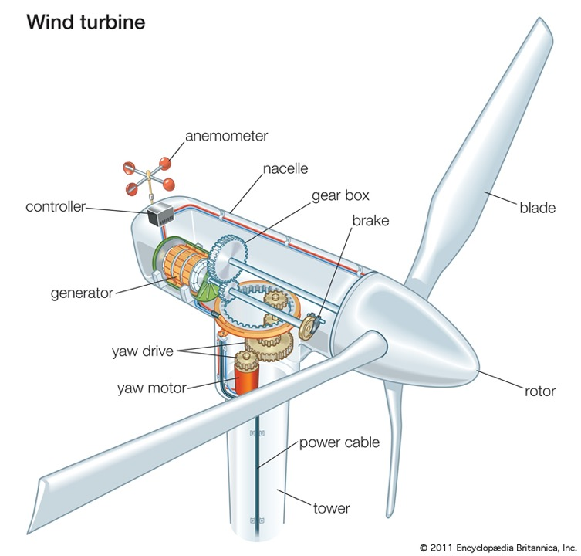
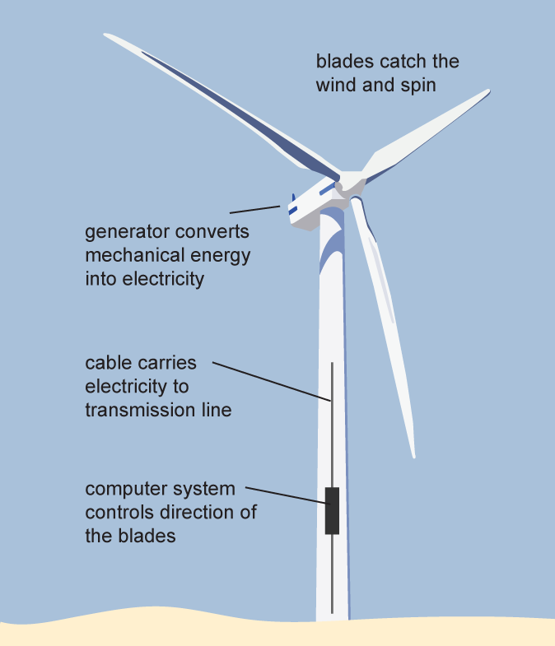
Wind Power – how does it work?
Source: Adapted from National Energy Education Development Project (public domain)
Notes:
DEMONSTRATION (2 MINS)
Point out on left hand diagram:
Blades, turbine, generator
Demonstrate squeezy or handle-operated torch – energy from my muscles making generator (also called dynamo) inside turn to generate electricity
QUESTION: is this vertical or horizontal axis? Horizontal.
Right hand diagram: note - top of turbine called nacelle. Generator consists of coils of wire and magnets.

Slide 10
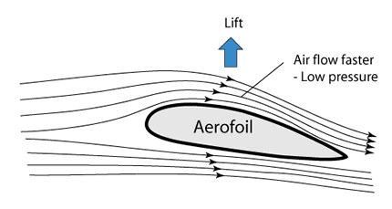
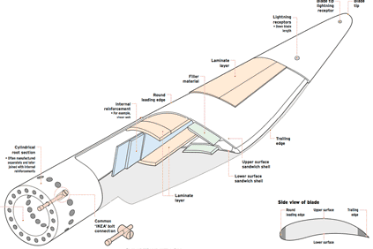
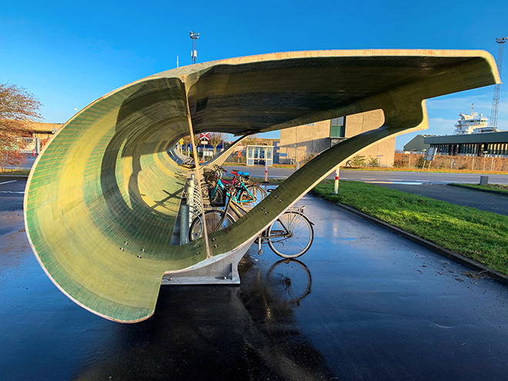
Aerofoil shape
https://www.researchgate.net/figure/Typical-parts-of-a-wind-turbines-blade-18_fig2_354751536
Superuse Studios, Port of Aalborg, WindEurope
Notes:
PRESENTING (2 MINS)
The shape of the blade is called an aerofoil. When the wind hits it, it exerts a force on it to make it turn – called LIFT. (There is also air resistance /friction which is unhelpful, so we make the blades really smooth). It’s the same shape as helicopter blades and aeroplane wings – here’s an old aeroplane wing recycled as a bike shelter!

Slide 11
How tall is a wind turbine?
2 m tall? (a tall person)
10 m tall? (the top diving board)
90 m tall? (a skyscraper, or the Statue of Liberty)
Notes:
QUESTION: MULTIPLE CHOICE (1 MIN)
Pupils can vote.
Answer: They vary!
Tallest turbines are off-shore (in the ocean)

Slide 12
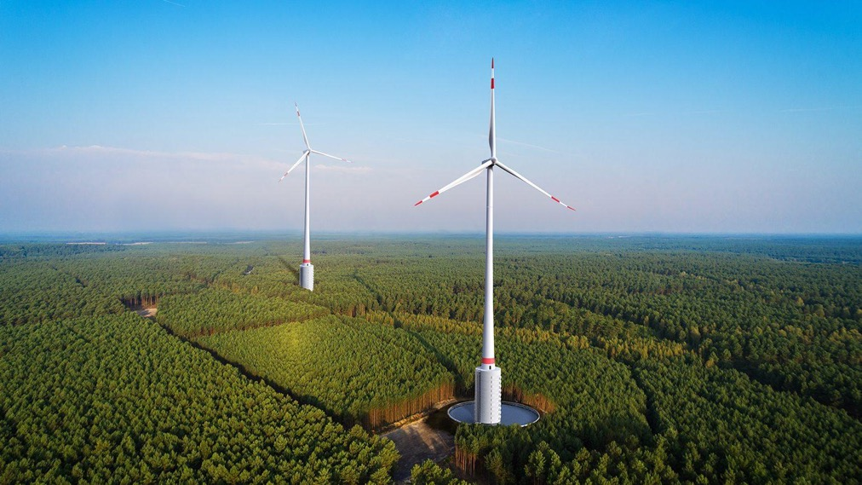
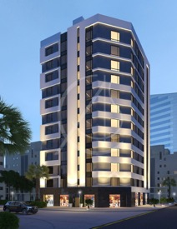
How tall is a wind turbine?
https://www.homify.co.uk
Max Bögl Wind
Notes:
PRESENTING (2 MINS)
Tallest on-shore turbines in the world are these new turbines in Germany. They are 250m high = 90-storey building.
The base alone = height of 12-storey building! [This is used for storing water which is pumped up during the night when elec demand is low, and falls back through a water turbine when demand is extra-high, like a power booster.]
Each turbine provides 4 megawatts of power (= 4 MW), each enough to power 2000 homes! Recall top of tower = nacelle.

Slide 13
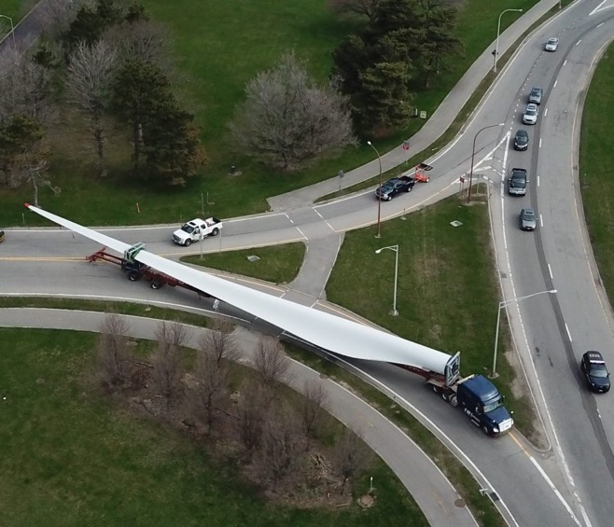
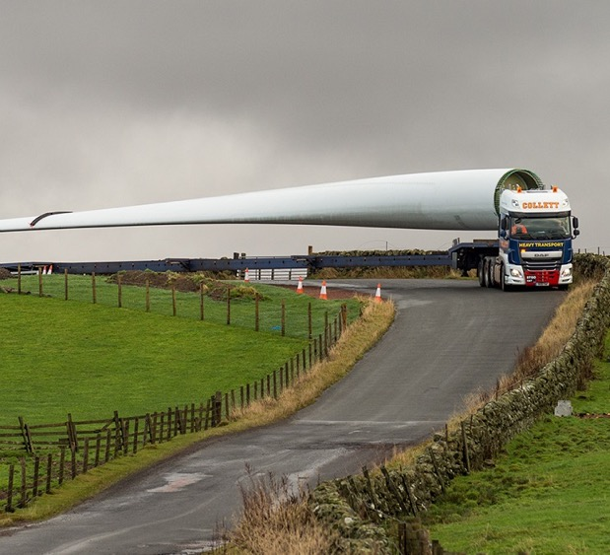
How big is a wind turbine blade?
John Hickey/Buffalo News
https://www.reddit.com/
Notes:
PRESENTING (1 MIN)
This is an ‘average’ size blade = 90 metres long!
Question: what problems might this cause, apart from transporting them? Could snap under own weight, so built as light and strong as possible

Slide 14
Inside the nacelle
Notes:
PRESENTING (1 MIN)
Recall the nacelle = the ‘housing’ at the top of the tower. Engineer and technicians have to climb up (sometimes there is a lift) for maintenance, etc.
Can you imagine how exciting it would be to have a job that involves going up there every day?....
Let’s meet 2 people who do!

Slide 15
Laura – Turbine technician, Siemens Gamesa Renewable Energy
Practical – Adventurous - Independent
“I keep the turbines running so that they continue provide power to the grid/home.
If you are practical then make it pay – and help the planet too!”
Notes:
PRESENTING (1 MIN)
Careers inspiration – “People like me”
Job involves servicing the turbines, fault finding, replacing parts, risk assessments, emergency rescue drills, following/completing safety documentation, climbing
Career pathway: apprenticeship in mechanical and electrical engineering

Slide 16
Alex – Engineer, London Array
Practical – Adventurous - Motivated
“I make sure the wind turbines perform as efficiently as possible, to supply as much electricity to the UK as possible.
Every day is different, I get to work with cutting edge technology and have some very interesting puzzles to solve!”
Notes:
PRESENTING (1 MIN)
Careers inspiration – “People like me”
I analyse the performance of the wind farm to assess where the main issues are. I then plan projects to fix any issues where necessary, and then write the relevant risk assessments and method statements to complete the tasks.
Career pathway: Masters degree in engineering

Slide 17
Experiment: What affects the turbine’s power?
If you have access to the Bright Sparks kit, you can demonstrate the 3 blades. Otherwise you can use the images on the next 2 slides:
Show or demonstrate the 3 turbine blade arrangements in turn
Ask students to predict which one will produce the highest voltage and why.
Ask students how to ensure a fair test (keep distance to hairdryer constant), and how to display results (bar chart).
Measure the voltage output of each (use multimeter on 20V dc setting, with red and black leads from generator connected to middle and right hand (“COM”) terminals respectively) and record in a table.
Pupils can display the results on a bar graph, compare them with their predictions and make a conclusion.

Slide 18
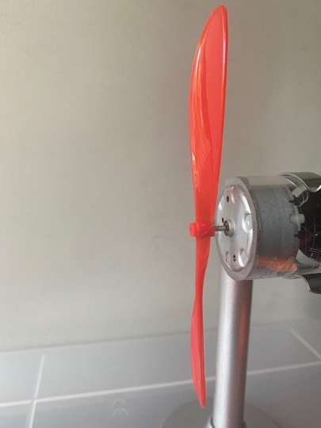
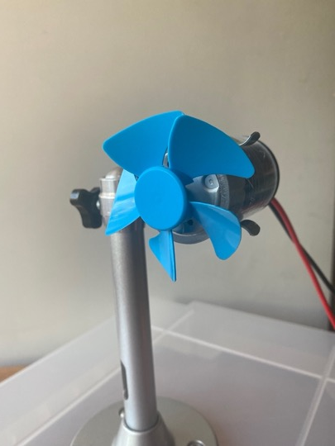
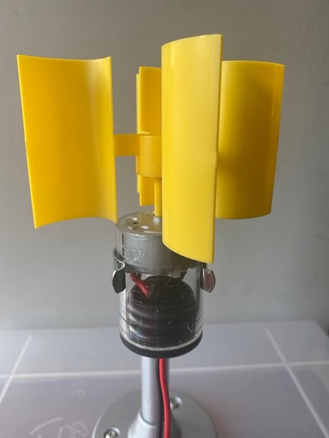
Prediction – which one will produce most power?
Four curved blades – yellow (NB. vertical axis!)
Two long thin blades - red
Five short wide blades - blue
Notes:
[Show this slide if you do not have access to Bright Sparks kit]
DISCUSSION (3 MINS)
Ask the pupils to make a prediction, with reasons. They should try to put them in rank order.
Reasons might include number or area of blades, or shape (but not colour!). You could ask them to record these predictions so they can check against outcomes.

Slide 19
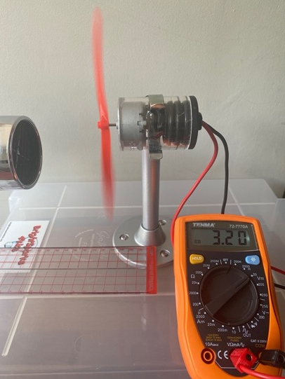
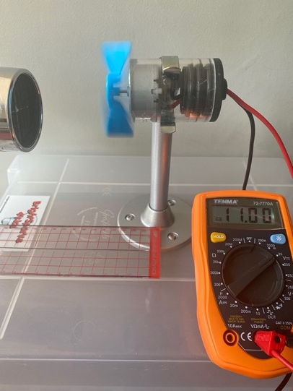
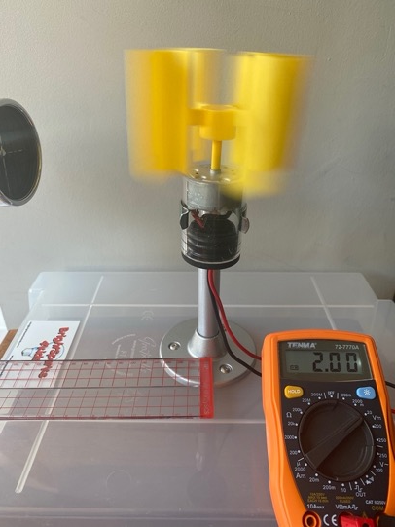
Did you predict correctly?
3.20 V
11.00 V
2.00 V
Notes:
[Results of experiment – show this slide if you do not have access to the kit.]
[Note: the yellow blades can be made to turn in both directions, clockwise and anticlockwise, by tilting the angle of the hairdryer. This gives positive and negative voltages.]
PRESENTATION (2 MIN)
Was this what you predicted? If not, why not? Why are the blue blades so powerful?

Slide 20
Using Bright Sparks wind turbine kit
Wind turbine kits are available from Bright Sparks (https://www.brightsparksedu.com/all-products), comprising a turbine tower, generator, 3 sample turbine blades, basic blades for experimenting, and a multimeter to measure output.
Demonstrate the kit using the 3 provided blades (yellow, blue, red), and using a hairdryer on cool setting to provide wind. Measure and record the voltage output each time.
Introduce/remind pupils of need for fair test (distance from and power of hairdryer)
Then show the ‘flat’ yellow blades. Pupils then attach materials (e.g. recycled card, cut-out plastic water bottles) to the blades to form a surface which will catch more air and improve the performance.
Design idea, build, test, redesign (iterative depending on time!)
You can set up a ‘testing rig’ in centre of room – ideally 1 per 25 children to test it out, while others do interim tests by ‘wafting’ or blowing.
The pupils give their design a name and record the improvement in output voltage (more important learning than actual output).
Notes:
OPTIONAL DESIGN-BUILD-TEST MAKING ACTIVITY (45 - 60 MINS) – USING COMMERCIALLY AVAILABLE KIT

Slide 21
Design – Build – Test
What if we could be like Laura and Alex, designing our own wind turbine blades to get more energy from the wind?
Notes:
INTRODUCTION TO ACTIVITY

Slide 22
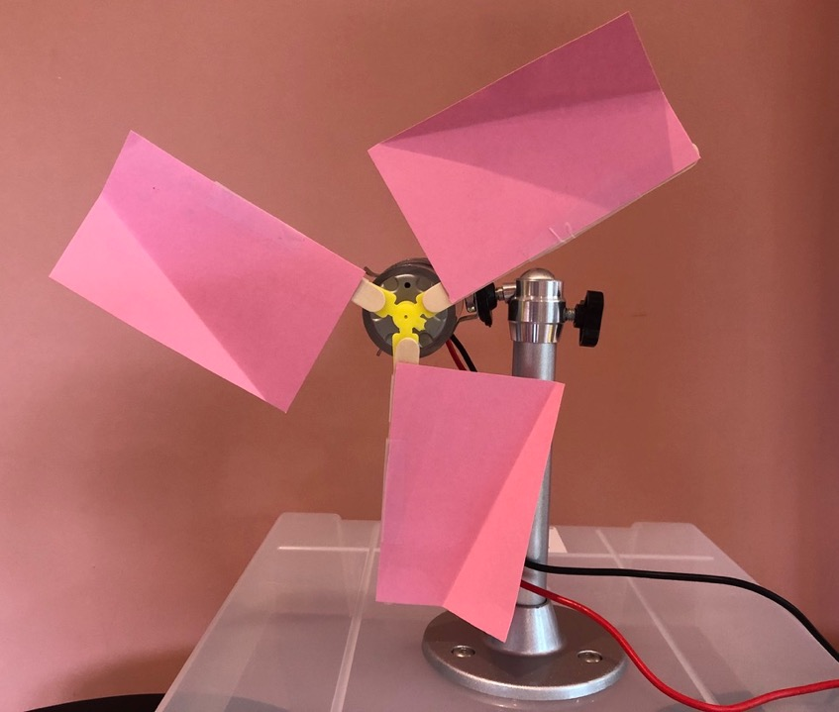
Notes:
1st attempt: Too big & floppy – didn’t even turn!

Slide 23
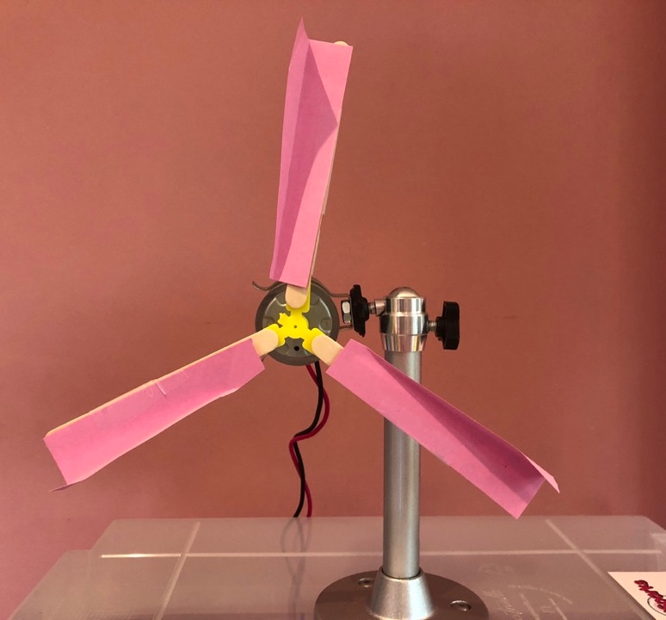
Notes:
2nd attempt: Lighter but not much rotation

Slide 24
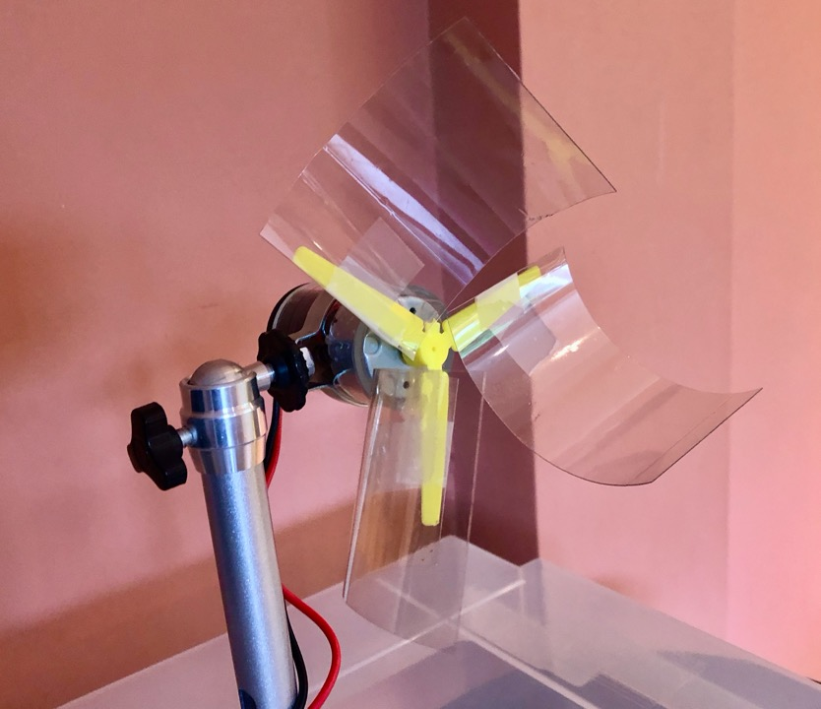
Notes:
3rd attempt – new material, from plastic water bottle – not good for planet! But very effective. A bit floppy – could do with being strengthened maybe with pipe cleaner?

Slide 25
Discussion – what have we learned?
Share your design with the class.
What did you change to improve your design?
What did you learn about being an engineer as part of a team?
When you go home today, what could you tell your family about this?
Notes:
DISCUSSION (3 MINS)
Emphasise the importance of testing the design and improving on it then testing again – this is what engineers do! Also, working together and bringing their own ideas to make a better design.
Encourage pupils to think about what they will share with people at home – an opportunity for oracy, improving science capital and home-school engagement.

Slide 26
DIY version – pictures on next slide
You can improvise as follows: stick 3 wooden lolly sticks into a central ball of blue tack or plasticene to form a simple turbine. Use a headed pin through the blue tack to secure it to the rubber tip of a pencil. Holding up the pencil, you should now have a simple turbine.
Then attach materials (e.g. recycled card, cut-out plastic water bottles) to the blades to form a surface which will catch more air and improve the performance. Design idea, build, test, redesign (iterative depending on time!)
Since the emphasis is on an iterative process of design-build-test, an absolute measurement of output is not necessary, but rather an improvement.
Possible measurements could be – slow-motion video to see how many rotations there are in 10s. Or attach the turbine to a cotton reel and use it to wind up a weight (e.g. a blob of plasticene) on a thread. For more ideas, visit: https://www.stem.org.uk/elibrary/resource/26094
Notes:
OPTIONAL DESIGN-BUILD-TEST MAKING ACTIVITY (45 - 60 MINS) – USING DIY KIT

Slide 27
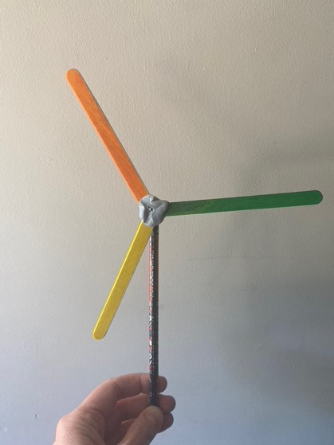
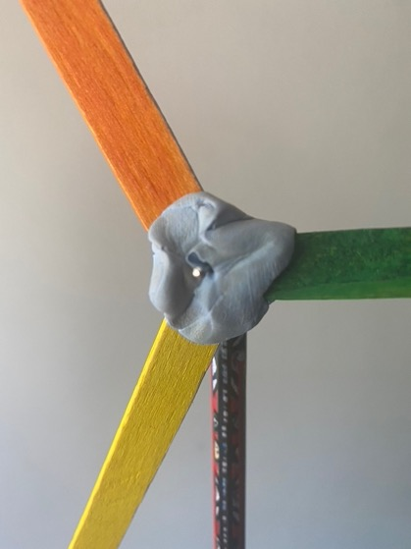
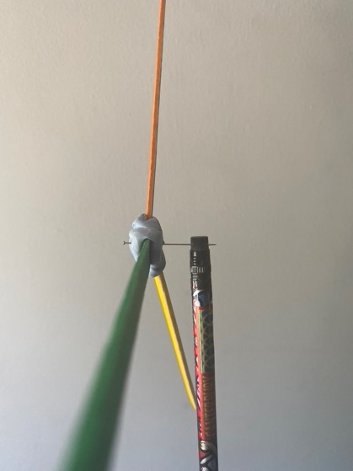
Notes:
PRESENTING & DISCUSSION (2-4 MINS)
Show how to make a basic wind turbine with lolly sticks, pencil, blue tack and pin as shown. Then explain to pupils that they can stick materials onto lolly sticks to improve the design. Discuss – how to measure improvement? See previous slide for ideas.

Slide 28
Notes:
1st attempt: Too big & floppy – didn’t even turn!

Slide 29
Notes:
2nd attempt: Lighter but not much rotation

Slide 30
Notes:
3rd attempt – new material, from plastic water bottle – not good for planet! But very effective. A bit floppy – could do with being strengthened maybe with pipe cleaner?

Slide 31
Discussion – what have we learned?
Share your design with the class.
What did you change to improve your design?
What did you learn about being an engineer as part of a team?
When you go home today, what could you tell your family about this?
Notes:
DISCUSSION (3 MINS)
Emphasise the importance of testing the design and improving on it then testing again – this is what engineers do! Also, working together and bringing their own ideas to make a better design.
Encourage pupils to think about what they will share with people at home – an opportunity for oracy, improving science capital and home-school engagement.

Slide 32
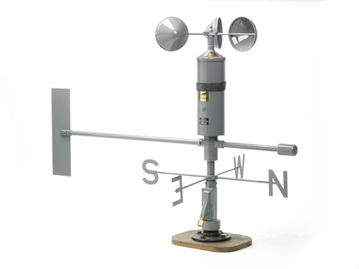
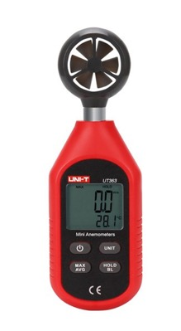
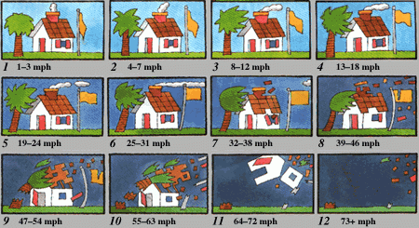
Wind speed
Ideal wind speed is between 5 and 25 m/s
https://www.universetoday.com
Notes:
PRESENTING (2 MINS)
It’s important to be able to measure wind speed! We use an anemometer to measure this – digital/cup varieties (look out for the cup variety in your neighbourhood on roofs)
Measured in miles per hour or metres per second or using Beaufort Scale (developed in the 1800s)
Less that 5 m/s too low to turn turbine.
So, where are good places to put wind turbines?

Slide 33
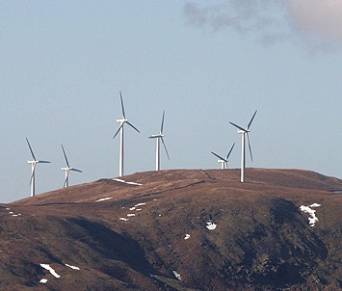
Ideal locations
Notes:
PRESENTING (1 MIN)
Where? Where it is windy! And preferably wind blowing in a predictable direction (‘prevailing’), e.g. on a hill, at sea. Also in valley – the sides of valley funnel the wind.

Slide 34
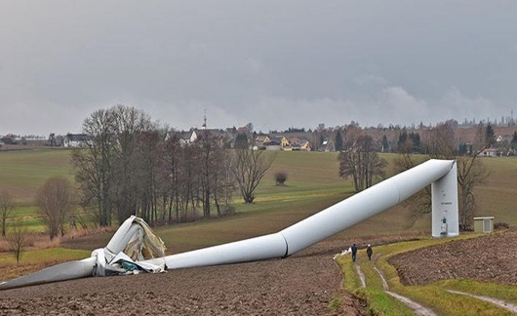
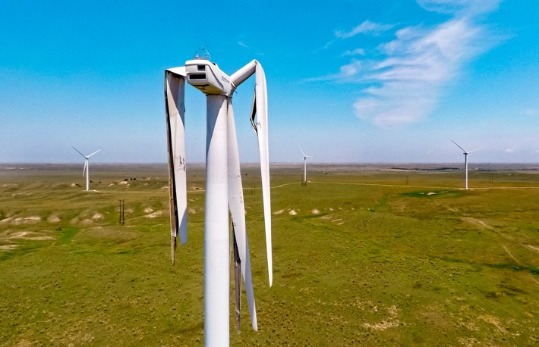
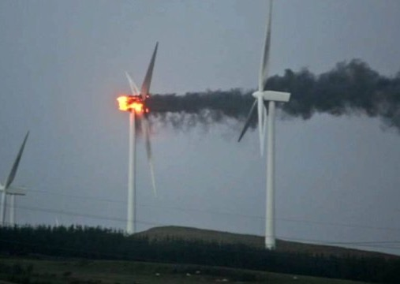
But if it’s too windy?
https://www.researchgate.net/figure/Wind-turbine-collapse-in-Germany-on-2017_fig1_345333135
https://eu.oklahoman.com
Notes:
PRESENTING (2 MINS)
With more wind you can generate more power – up to a point. Needs some wind to overcome friction of rotors (> 5 m/s).
But over about 25 m/s it’s too dangerous:
blade might break/tower might topple/generator might overheat and catch fire.
But turbines are designed to be stopped by brakes if wind too high (even a gust)
Sometimes turbines stop because there’s already too much renewable power going into the National Grid.

Slide 35
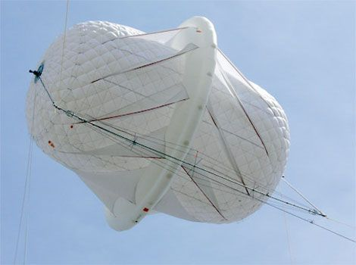
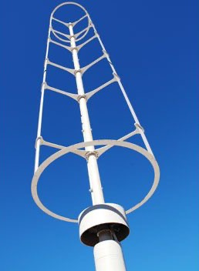
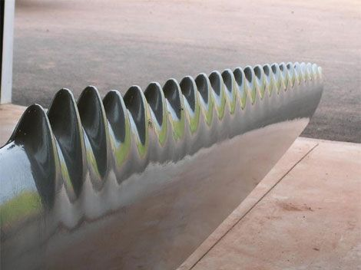
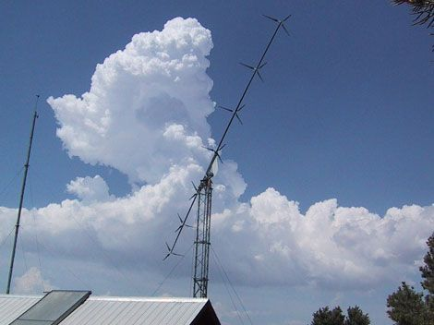
New innovations
SpeakerFactory.net
https://www.windspireenergy.com
www.ijera.com
WhalePower
Notes:
www.ijera.com
PRESENTING (3 MINS)
4 new experimental designs:
Serrated blades, based on humpback whales – increase power x 20%
Windspire – quieter & works in any wind direction – ideal for urban environments
Sky serpent – lots of rotors in a long line
Air rotor system – tethered helium balloon rotates
Another innovation is reported here – wind turbines on lampposts help power the street lights: https://www.bbc.co.uk/news/uk-england-shropshire-61337814

Slide 36
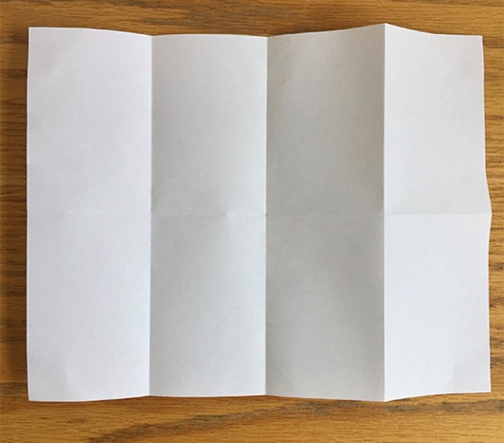
My ‘zine’
Fold your sheet of paper in half. Fold it again into quarters, and then one more time so that it is folded into eighths.
Notes:
PRESENTING (1 MIN)
Possible follow-up activity

Slide 37
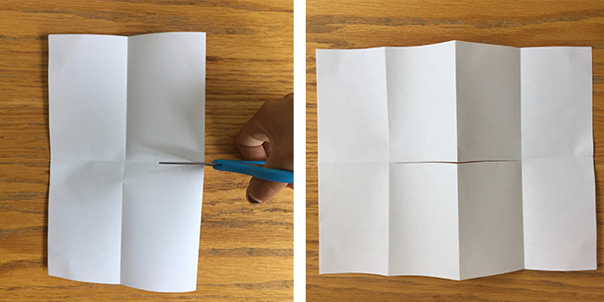
Open your paper so that it is folded in half.
Cut halfway across the middle from the fold.
When you open your paper it should have a slit in the middle.

Slide 38
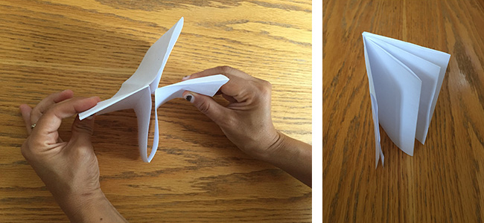
Fold your paper lengthwise (along the crease that has the slit).
Hold the paper at either end, then push the ends in toward each other.
The sections should fold into each other to form an eight-page booklet.

Slide 39
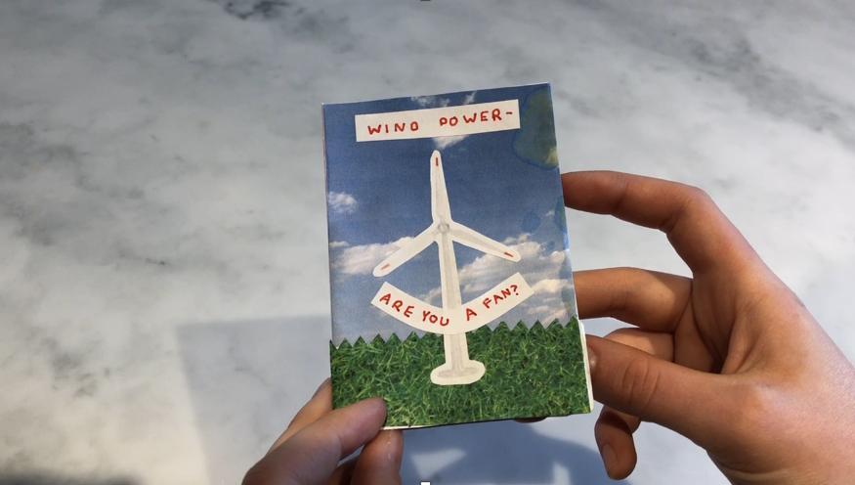
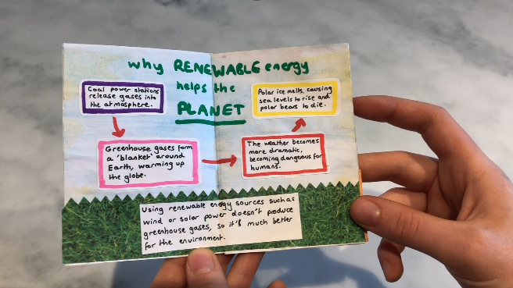



Sample ‘zine’

Slide 40
Ideas for your ‘zine’
Front Title “Wind power – are you a fan?”
P2-3 Why renewable energy helps the planet
P4-5 Experimenting with wind: what we did
P6-7 What I learned about being an engineer
Back Key words I have learned
Notes:
KS2

Slide 41
Terms we have used today:
Innovation
Wind turbine
Vertical axis
Horizontal axis
Nacelle
Aerofoil
Anemometer
Generator
Dynamo
Blades
Wind farm
Offshore wind farm
Notes:
PRESENTING (1 MIN)
These could be collated on the board or a flip chart through the workshop.

Slide 42
What have we learned today?
Why electricity is useful
Why renewable energy like wind is better for the planet
Key terms…
How a wind turbine works
Experiments about wind turbine blades…
Meeting people who work in science to help us
Any questions?
Notes:
DISCUSSION (1 MIN) - ADAPT AS NEEDED

Slide 43
Further ideas/resources
Make a ‘zine’ and share with parents
Improve your wind turbine blade design and share your results!
Create a class/school display about wind power
Look out for wind turbines near your school and make a map
Find news stories about global warming
Notes:
PRESENTING (1 MIN) - OPTIONAL

Slide 44
Careers follow-up Q&A
Finding a role model
Contact your local STEM Ambassadors hub to see if there is someone from the wind power industry who could help. Or get in touch with your nearest wind power provider.
During the Q&A session:
Agree a time limit – say 20-30 minutes.
The role models could introduce themselves, describe their jobs and ask the children what they learned in the workshop.
The children could then ask the questions they have prepared.
Ask the role models if they have any resources/information they could share.
Follow up:
The children could write to the role models and thank them.
They could write up a piece (cross-curricular literacy gain) on their meeting, or what they learned about being an engineer/technician/scientist, or a persuasive piece, e.g. why we should all study sciences.
Preparation:
After the workshop, ask the children to think about jobs relating to what they learned and reflect on the role models they were shown.
If they were to meet them, what would they want to ask them?
You might consider prompting with these questions:
What do you do in a typical day?
Do you enjoy your job?
What tools and other things do you need to do your job?
Where do you spend most of your day?
What made you want to do this job? What was your route into it?
What were you like at school?
What do you do in your spare time?
Would you recommend your job? How would I find out more? What could I do now to become a scientist/engineer?
What’s the weirdest thing you’ve done in your job?
Do you think you make a difference to the world?
What are the new/future developments in your work?
Would you like to stay in this job for a long time or do you have other plans?
Notes:
Optional careers follow-up

